Slide 1
Subroutines

Slide 2
Outline
Introduction to subroutines
Introduction to Stacks
Saving and restoring registers
Parameter passing through stack
Local variables

Slide 3
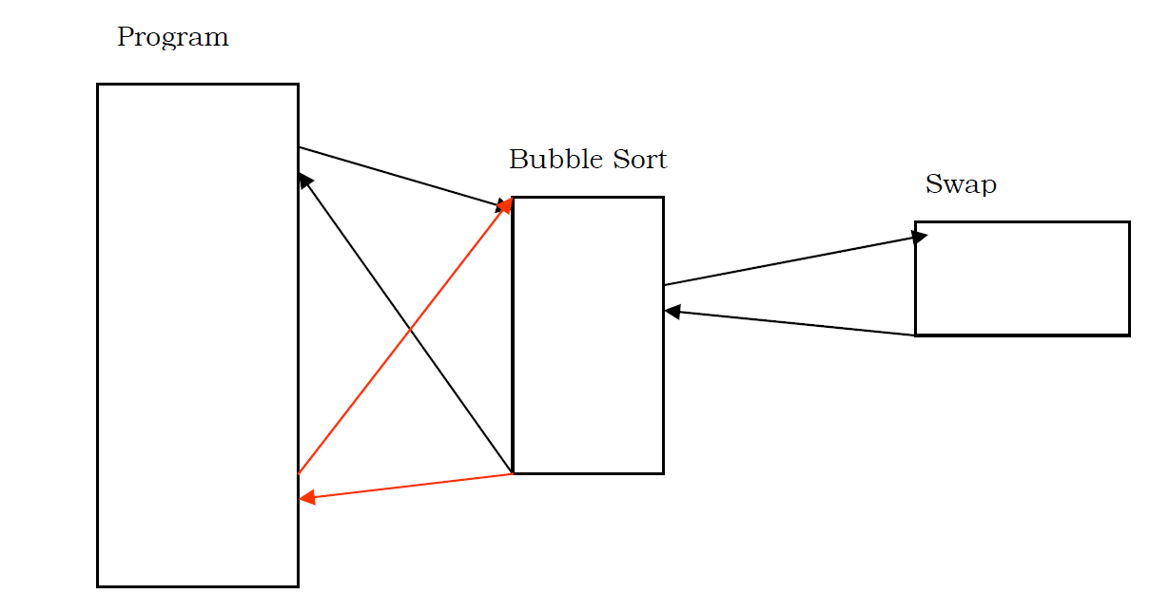
Introduction to subroutines

Slide 4
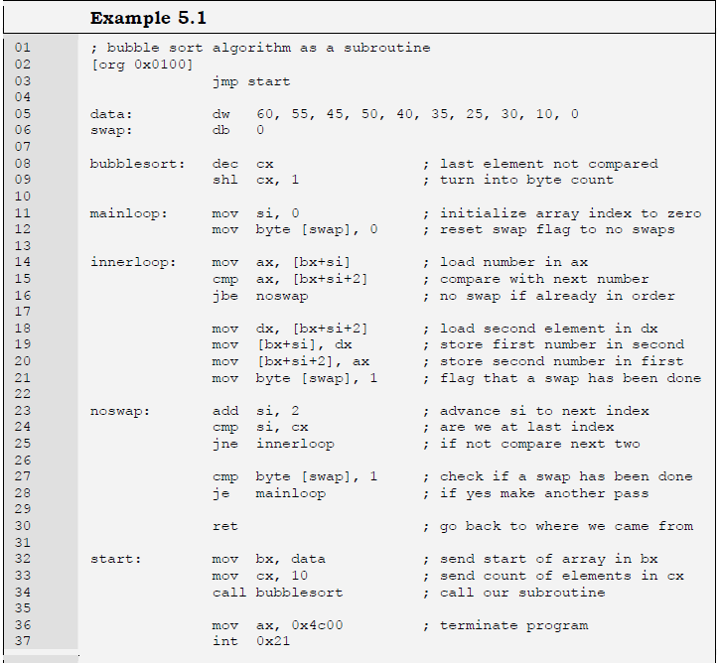

Slide 5
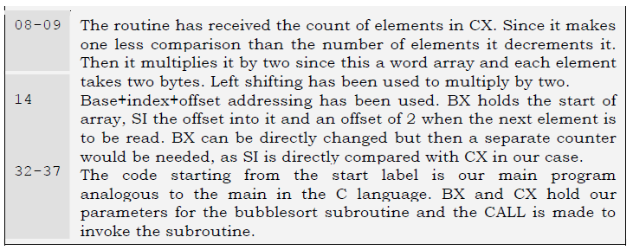
Example 5.1.

Slide 6
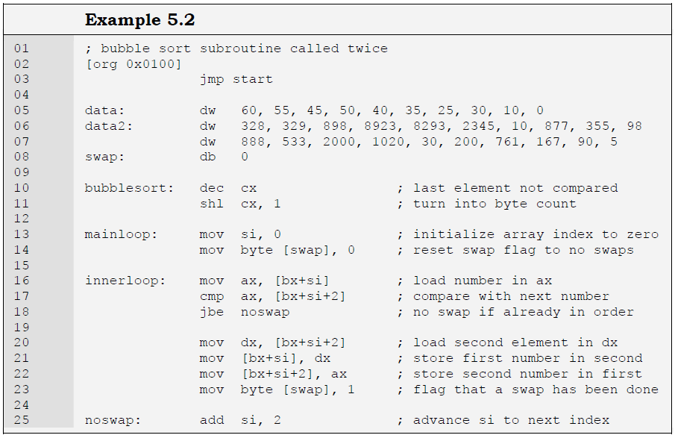

Slide 7
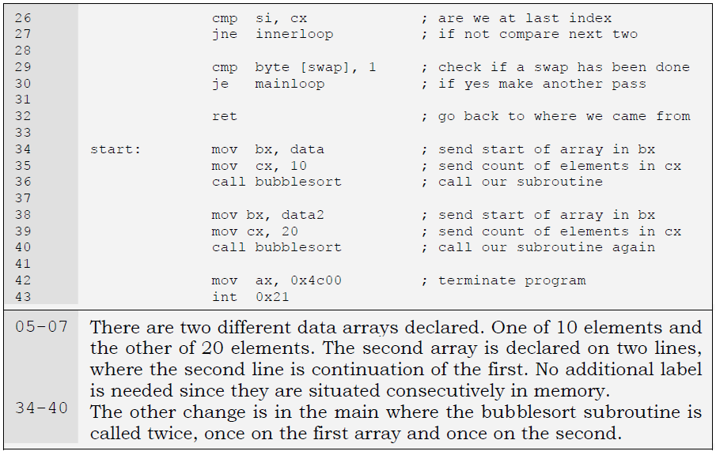

Slide 8
Stacks
Stack is a data structure that behaves in a first in last out manner.
It can contain many elements and there is only one way in and out of the container.
When an element is inserted it sits on top of all other elements and when an element is removed the one sitting at top of all others is removed first.
To visualize the structure consider a test tube and put some balls in it.
The second ball will come above the first and the third will come above the second.
When a ball is taken out only the one at the top can be removed.
The operation of placing an element on top of the stack is called pushing the element and the operation of removing an element from the top of the stack is called popping the element.
The last thing pushed is popped out first; the last in first out behavior.

Slide 9
We can peek at any ball inside the test tube but we cannot remove it without removing every ball on top of it.
Similarly we can read any element from the stack but cannot remove it without removing everything above it.
The stack operations of pushing and popping only work at the top of the stack.
This top of stack is contained in the SP register.
The physical address of the stack is obtained by the SS:SP combination.
The stack segment registers tells where the stack is located and the stack pointer marks the top of stack inside this segment.

Slide 10
Whenever an element is pushed on the stack SP is decremented by two as the 8088 stack works on word sized elements.
Single bytes cannot be pushed or popped from the stack.
Also it is a decrementing stack.
Another possibility is an incrementing stack.
A decrementing stack moves from higher addresses to lower addresses as elements are added in it while an incrementing stack moves from lower addresses to higher addresses as elements are added.
There is no special reason or argument in favor of one or another, and more or less depends on the choice of the designers.
Another processor 8051 by the same manufacturer has an incrementing stack while 8088 has a decrementing one.

Slide 11
Memory is like a shelf numbered as zero at the top and the maximum at the bottom.
If a decrementing stack starts at shelf 5, the first item is placed in shelf 5, the next item is placed in shelf 4, the next in shelf 3 and so on.
The operations of placing items on the stack and removing them from there are called push and pop.
The push operation copies its operand on the stack, while the pop operation makes a copy from the top of the stack into its operand.
When an item is pushed on a decrementing stack, the top of the stack is first decremented and the element is then copied into this space.
With a pop the element at the top of the stack is copied into the pop operand and the top of stack is incremented afterwards.

Slide 12
The basic use of the stack is to save things and recover from there when needed.
For example we discussed the shortcoming in our last example that it destroyed the caller’s registers, and the callers are not supposed to remember which registers are destroyed by the thousand routines they use.
Using the stack the subroutine can save the caller’s value of the registers on the stack, and recover them from there before returning.
Meanwhile the subroutine can freely use the registers.
From the caller’s point of view if the registers contain the same value before and after the call, it doesn’t matter if the subroutine used them meanwhile.

Slide 13
Similarly during the CALL operation, the current value of the instruction pointer is automatically saved on the stack, and the destination of CALL is loaded in the instruction pointer.
Execution therefore resumes from the destination of CALL.
When the RET instruction is executed, it recovers the value of the instruction pointer from the stack.
The next instruction executed is therefore the one following the CALL.
Observe how playing with the instruction pointer affects the program flow.
There is a form of the RET instruction called “RET n” where n is a numeric argument.
After performing the operation of RET, it further increments the stack pointer by this number, i.e. SP is first incremented by two and then by n.
Its function will become clear when parameter passing is discussed.

Slide 14
Now we describe the operation of the stack in CALL and RET with an example.
The top of stack stored in the stack pointer is initialized at 2000.
The space above SP is considered empty and free.
When the stack pointer is decremented by two, we took a word from the empty space and can use it for our purpose.
The unit of stack operations is a word.
Some instructions push multiple words; however byte pushes cannot be made.
Now the value 017B is stored in the word reserved on the stack.
The RET will copy this value in the instruction pointer and increment the stack pointer by two making it 2000 again, thereby reverting the operation of CALL.
This is how CALL and RET behave for near calls.
There is also a far version of these functions when the target routine is in another segment.
This version of CALL takes a segment offset pair just like the far jump instruction.
The CALL will push both the segment and the offset on the stack in this case, followed by loading CS and IP with the values given in the instruction.
The corresponding instruction RETF will pop the offset in the instruction pointer followed by popping the segment in the code segment register.

Slide 15
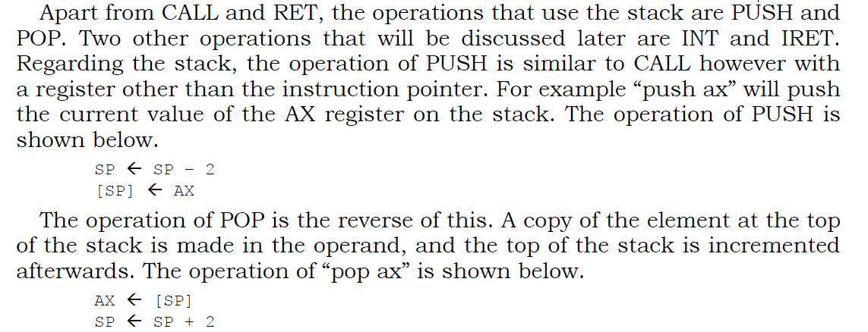

Slide 16
Making corresponding PUSH and POP operations is the responsibility of the programmer.
If “push ax” is followed by “pop dx” effectively copying the value of the AX register in the DX register, the processor won’t complain.
Whether this sequence is logically correct or not should be ensured by the programmer.
For example when PUSH and POP are used to save and restore registers from the stack, order must be correct so that the saved value of AX is reloaded in the AX register and not any other register.
For this the order of POP operations need to be the reverse of the order of PUSH operations.

Slide 17
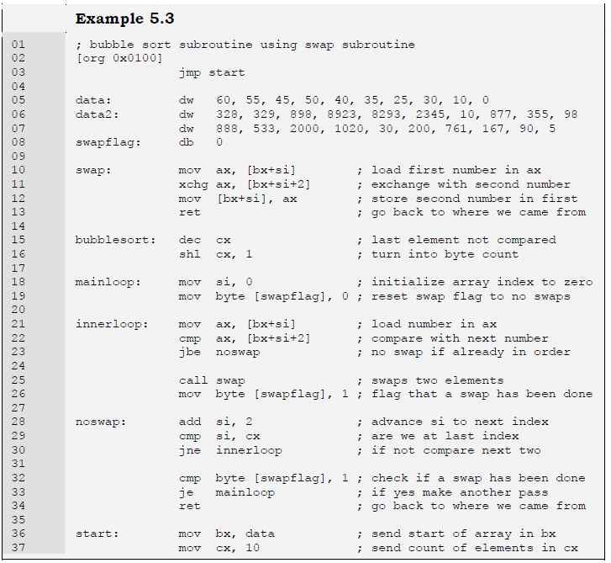

Slide 18
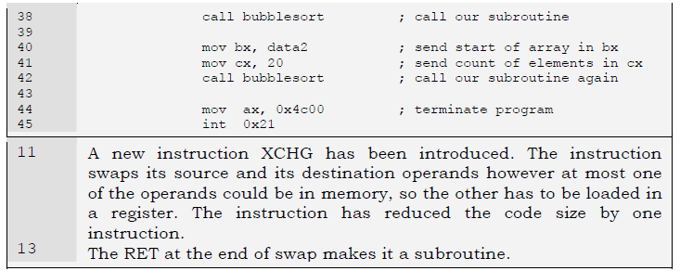

Slide 19
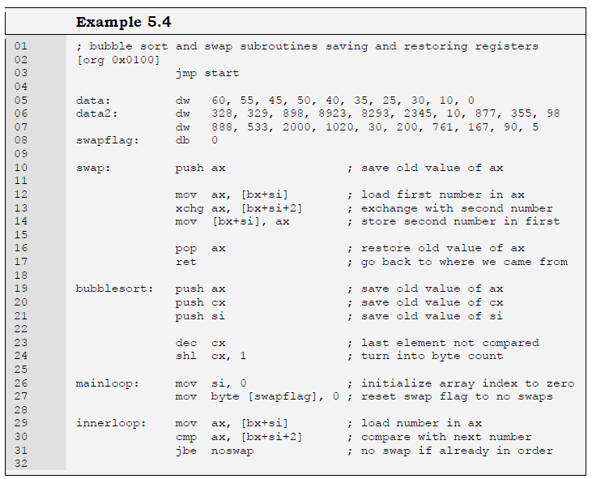
Saving and restoring registers

Slide 20
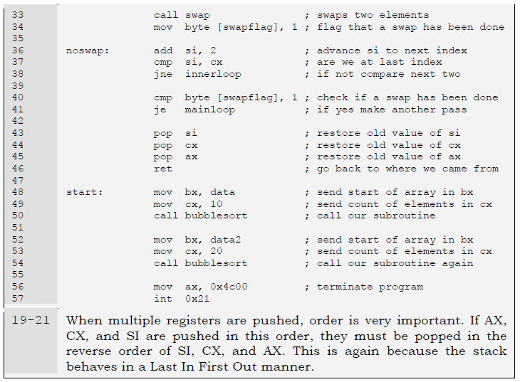

Slide 21
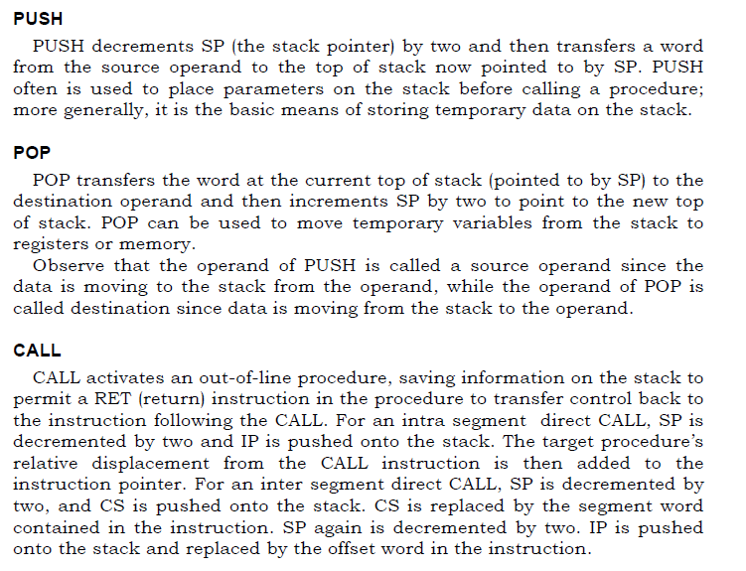

Slide 22
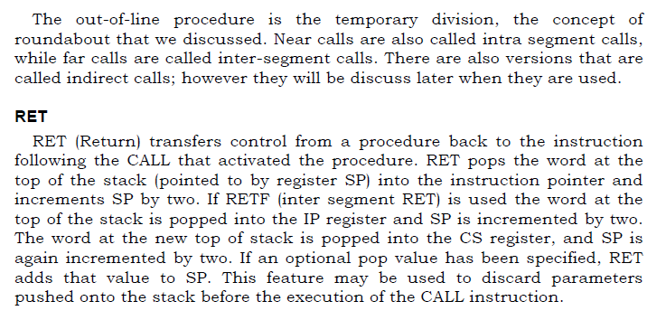

Slide 23
Parameter passing through Stack
Due to the limited number of registers, parameter passing by registers is constrained in two ways.
The maximum parameters a subroutine can receive are seven when all the general registers are used.
Also, with the subroutines are themselves limited in their use of registers, and this limited increases when the subroutine has to make a nested call thereby using certain registers as its parameters.
Due to this, parameter passing by registers is not expandable and generalizable. However this is the fastest mechanism available for passing parameters and is used where speed is important.

Slide 24
Considering stack as an alternate, we observe that whatever data is placed there, it stays there, and across function calls as well.
For example the bubble sort subroutine needs an array address and the count of elements.
If we place both of these on the stack, and call the subroutine afterwards, it will stay there.
The subroutine is invoked with its return address on top of the stack and its parameters beneath it.

Slide 25
To access the arguments from the stack, the immediate idea that strikes is to pop them off the stack.
And this is the only possibility using the given set of information.
However the first thing popped off the stack would be the return address and not the arguments.
This is because the arguments were first pushed on the stack and the subroutine was called afterwards.
The arguments cannot be popped without first popping the return address.
If a heaving thing falls on someone’s leg, the heavy thing is removed first and the leg is not pulled out to reduce the damage.
Same is the case with our parameters on which the return address has fallen.

Slide 26
To handle this using PUSH and POP, we must first pop the return address in a register, then pop the operands, and push the return address back on the stack so that RET will function normally.
However so much effort doesn’t seem to pay back the price.
Processor designers should have provided a logical and neat way to perform this operation.
They did provided a way and infact we will do this without introducing any new instruction.

Slide 27
Recall that the default segment association of the BP register is the stack segment and the reason for this association had been deferred for now.
The reason is to peek inside the stack using the BP register and read the parameters without removing them and without touching the stack pointer.
The stack pointer could not be used for this purpose, as it cannot be used in an effective address.
It is automatically used as a pointer and cannot be explicitly used.
Also the stack pointer is a dynamic pointer and sometimes changes without telling us in the background.
It is just that whenever we touch it, it is where we expect it to be.
The base pointer is provided as a replacement of the stack pointer so that we can peek inside the stack without modifying the structure of the stack.

Slide 28
When the bubble sort subroutine is called, the stack pointer is pointing to the return address.
Two bytes below it is the second parameter and four bytes below is the first parameter.
The stack pointer is a reference point to these parameters.
If the value of SP is captured in BP, then the return address is located at [bp+0], the second parameter is at [bp+2], and the first parameter is at [bp+4].
This is because SP and BP both had the same value and they both defaulted to the same segment, the stack segment.

Slide 29
This copying of SP into BP is like taking a snapshot or like freezing the stack at that moment.
Even if more pushes are made on the stack decrementing the stack pointer, our reference point will not change.
The parameters will still be accessible at the same offsets from the base pointer.
If however the stack pointer increments beyond the base pointer, the references will become invalid.
The base pointer will act as the datum point to access our parameters.
However we have destroyed the original value of BP in the process, and this will cause problems in nested calls where both the outer and the inner subroutines need to access their own parameters.
The outer subroutine will have its base pointer destroyed after the call and will be unable to access its parameters.

Slide 30
To solve both of these problems, we reach at the standard way of accessing
parameters on the stack.
The first two instructions of any subroutines accessing its parameters from the stack are given below:
push bp
mov bp, sp
As a result our datum point has shifted by a word.
Now the old value of BP will be contained in [bp] and the return address will be at [bp+2].
The second parameters will be [bp+4] while the first one will be at [bp+6].
We give an example of bubble sort subroutine using this standard way of argument passing through stack.

Slide 31
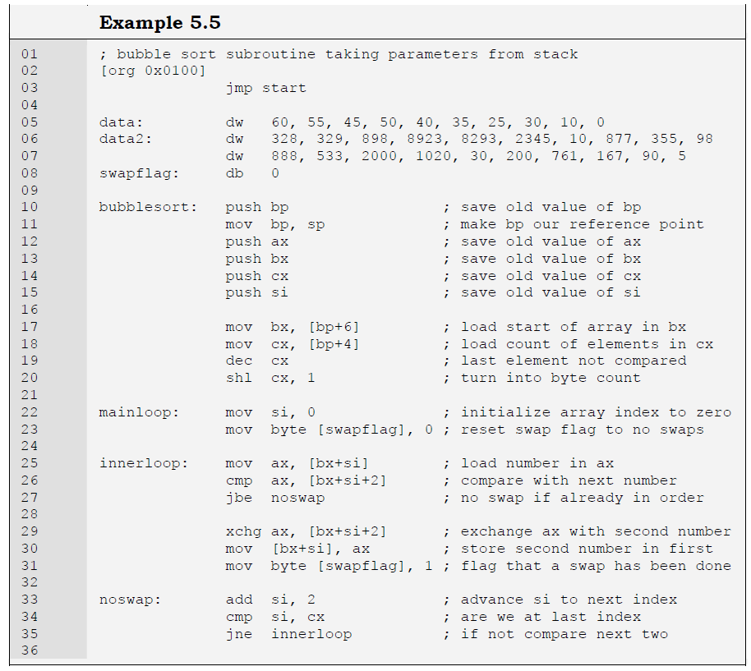

Slide 32
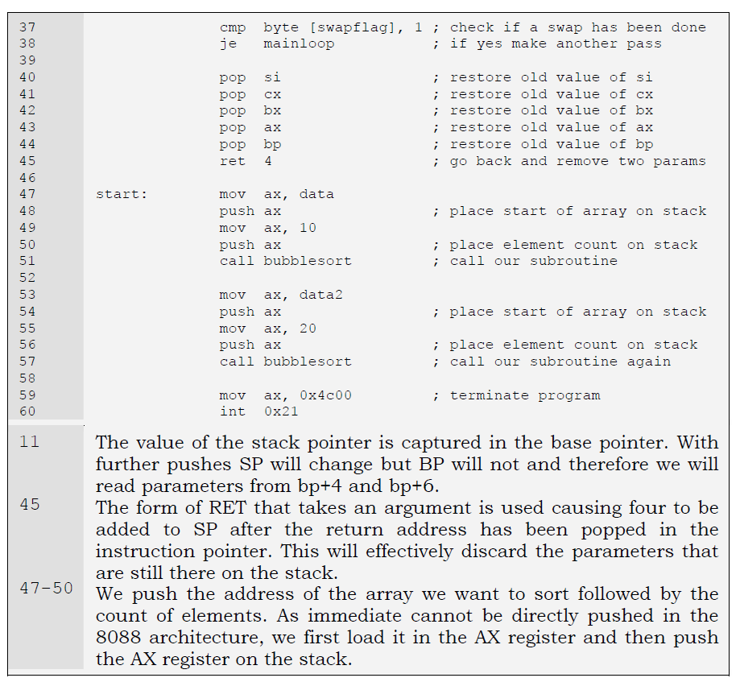

Slide 33
Stack Clearing by Caller or Callee
Parameters pushed for a subroutine are a waste after the subroutine has returned. They have to be cleared from the stack.
Either of the caller and the callee can take the responsibility of clearing them from there.
If the callee has to clear the stack it cannot do this easily unless RET n exists.
That is why most general processors have this instruction.
Stack clearing by the caller needs an extra instruction on behalf of the caller after every call made to the subroutine, unnecessarily increasing instructions in the program.
If there are thousand calls to a subroutine the code to clear the stack is repeated a thousand times.
Therefore the prevalent convention in most high level languages is stack clearing by the callee; even though the other convention is still used in some languages.

Slide 34
If RET n is not available, stack clearing by the callee is a complicated process.
It will have to save the return address in a register, then remove the parameters, and then place back the return address so that RET will function.
When this instruction was introduced in processors, only then high level language designers switched to stack clearing by the callee.
This is also exactly why RET n adds n to SP after performing the operation of RET.
The other way around would be totally useless for our purpose.
Consider the stack condition at the time of RET and this will become clear why this will be useless.
Also observe that RET n has discarded the arguments rather than popping them as they were no longer of any use either of the caller or the callee.

Slide 35
The strong argument in favour of callee cleared stacks is that the arguments were placed on the stack for the subroutine, the caller did not needed them for itself, so the subroutine is responsible for removing them.
Removing the arguments is important as if the stack is not cleared or is partially cleared the stack will eventually become full, SP will reach 0, and thereafter wraparound producing unexpected results.
This is called stack overflow. Therefore clearing anything placed on the stack is very important.

Slide 36
Local variables
Another important role of the stack is in the creation of local variables that are only needed while the subroutine is in execution and not afterwards.
They should not take permanent space like global variables.
Local variables should be created when the subroutine is called and discarded afterwards.
So that the spaced used by them can be reused for the local variables of another subroutine.
They only have meaning inside the subroutine and no meaning outside it.

Slide 37
The most convenient place to store these variables is the stack.
We need some special manipulation of the stack for this task.
We need to produce a gap in the stack for our variables.
This is explained with the help of the swapflag in the bubble sort example.

Slide 38
The swapflag we have declared as a word occupying space permanently is only needed by the bubble sort subroutine and should be a local variable.
Actually the variable was introduced with the intent of making it a local variable at this time.
The stack pointer will be decremented by an extra two bytes thereby producing a gap in which a word can reside.
This gap will be used for our temporary, local, or automatic variable; however we name it.
We can decrement it as much as we want producing the desired space, however the decrement must be by an even number, as the unit of stack operation is a word.
In our case we needed just one word. Also the most convenient position for this gap is immediately after saving the value of SP in BP.
So that the same base pointer can be used to access the local variables as well; this time using negative offsets.
The standard way to start a subroutine which needs to access parameters and has local variables is as under.
push bp
mov bp, sp
sub sp, 2

Slide 39
The gap could have been created with a dummy push, but the subtraction makes it clear that the value pushed is not important and the gap will be used for our local variable.
Also gap of any size can be created in a single instruction with subtraction.
The parameters can still be accessed at bp+4 and bp+6 and the swapflag can be accessed at bp-2.
The subtraction in SP was after taking the snapshot; therefore BP is above the parameters but below the local variables.
The parameters are therefore accessed using positive offsets from BP and the local variables are accessed using negative offsets.
We modify the bubble sort subroutine to use a local variable to store the swap flag.
The swap flag remembered whether a swap has been done in a particular iteration of bubble sort.

Slide 40
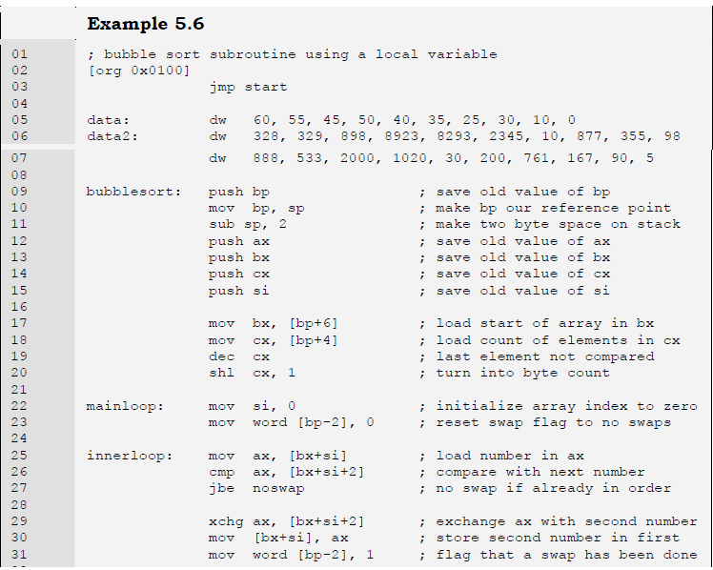

Slide 41
